Slide 1
Deep Learning Project
Classifying Heart Condition
Presented By: Saleh Aljomyl

Slide 2
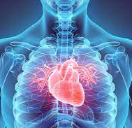
TABLE OF CONTENTS
Project Goal
Dataset And EDA
Model Baseline
Data Preprocessing
Neural Networks

Slide 3

Objectives
Approximately 29% of the global deaths are caused by Cardiovascular diseases.
The main goal of this project is to classify the heart condition from a heart rate audio.

Slide 4
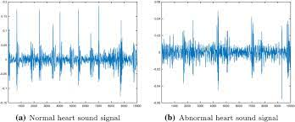

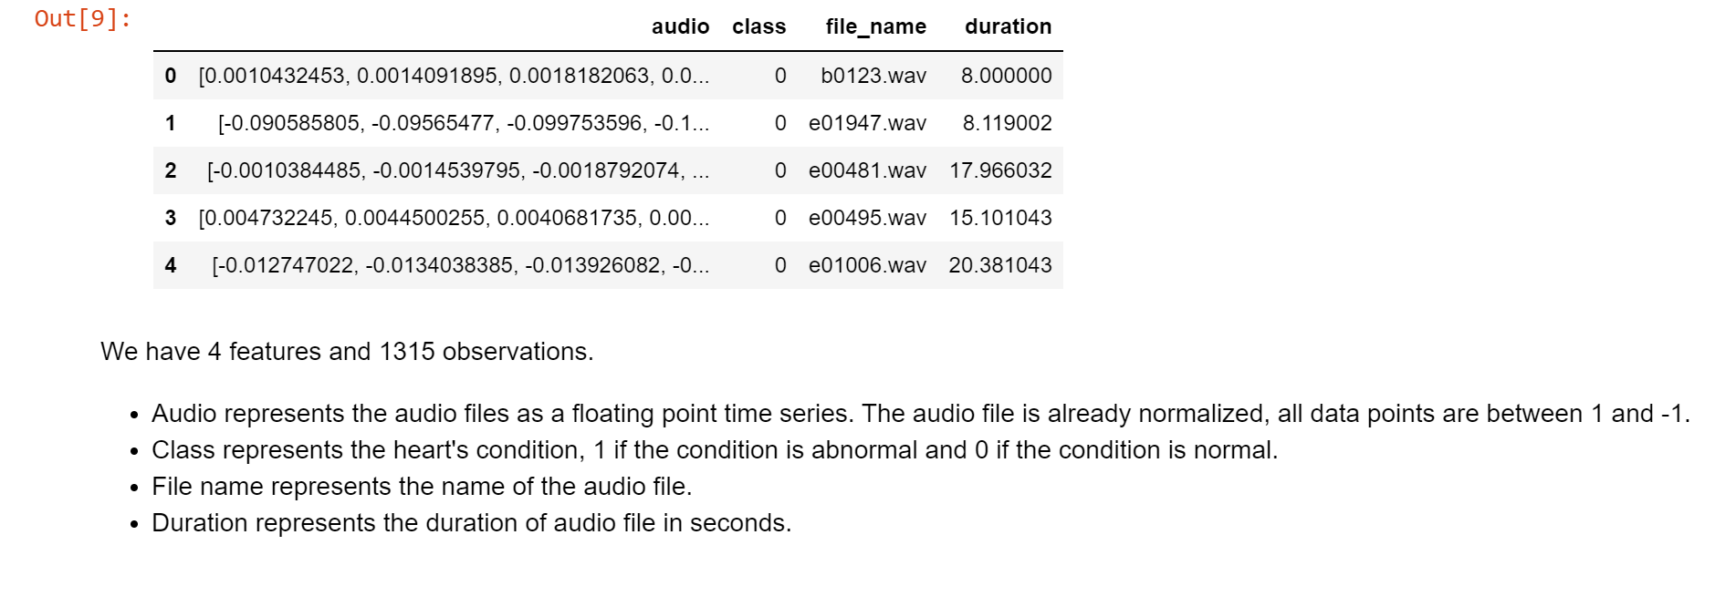
Dataset
Heart sound dataset was collected from physioNet website.
The dataset contains 1315 original PCG recordings in .wav format.
Audio files are labeled as 0 "Normal Heart Sound" and 1 "Abnormal Heart Sound".

Slide 5
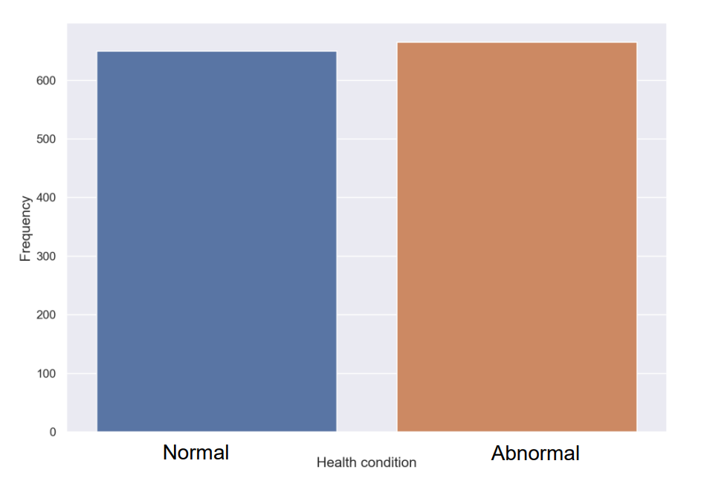
EDA: Distribution of Class

Slide 6
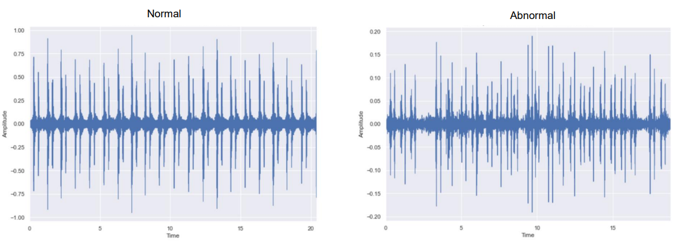
EDA: Wave plots

Slide 7
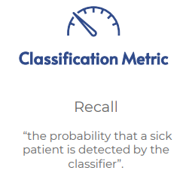
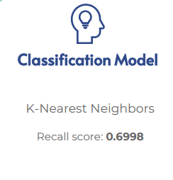
Model Baseline

Slide 8

Tools

Slide 9
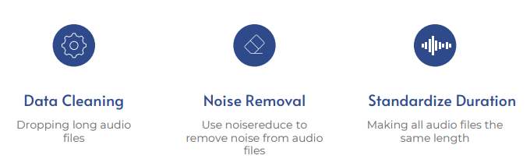
Data Preprocessing

Slide 10

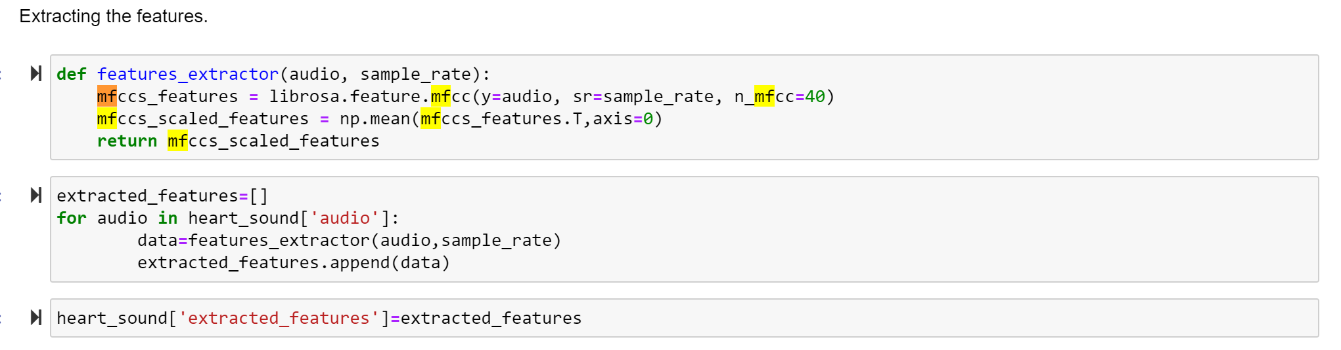
Extracting The Features

Slide 11
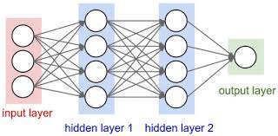
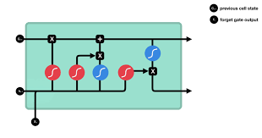
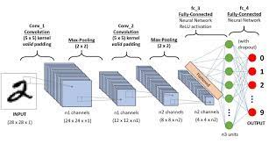
Neural Network Models
Feed Forward Neural Network
Long Short-Term Memory Neural Network
Convolutional Neural Network

Slide 12
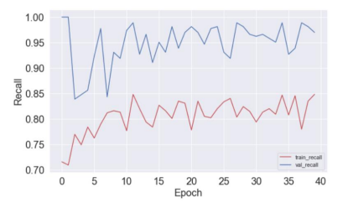

Feed Forward Neural Network
Hyperparameters
Hidden Layers: 2
Epochs: 40
Batch Size: 32
Dropout: 0.5

Slide 13
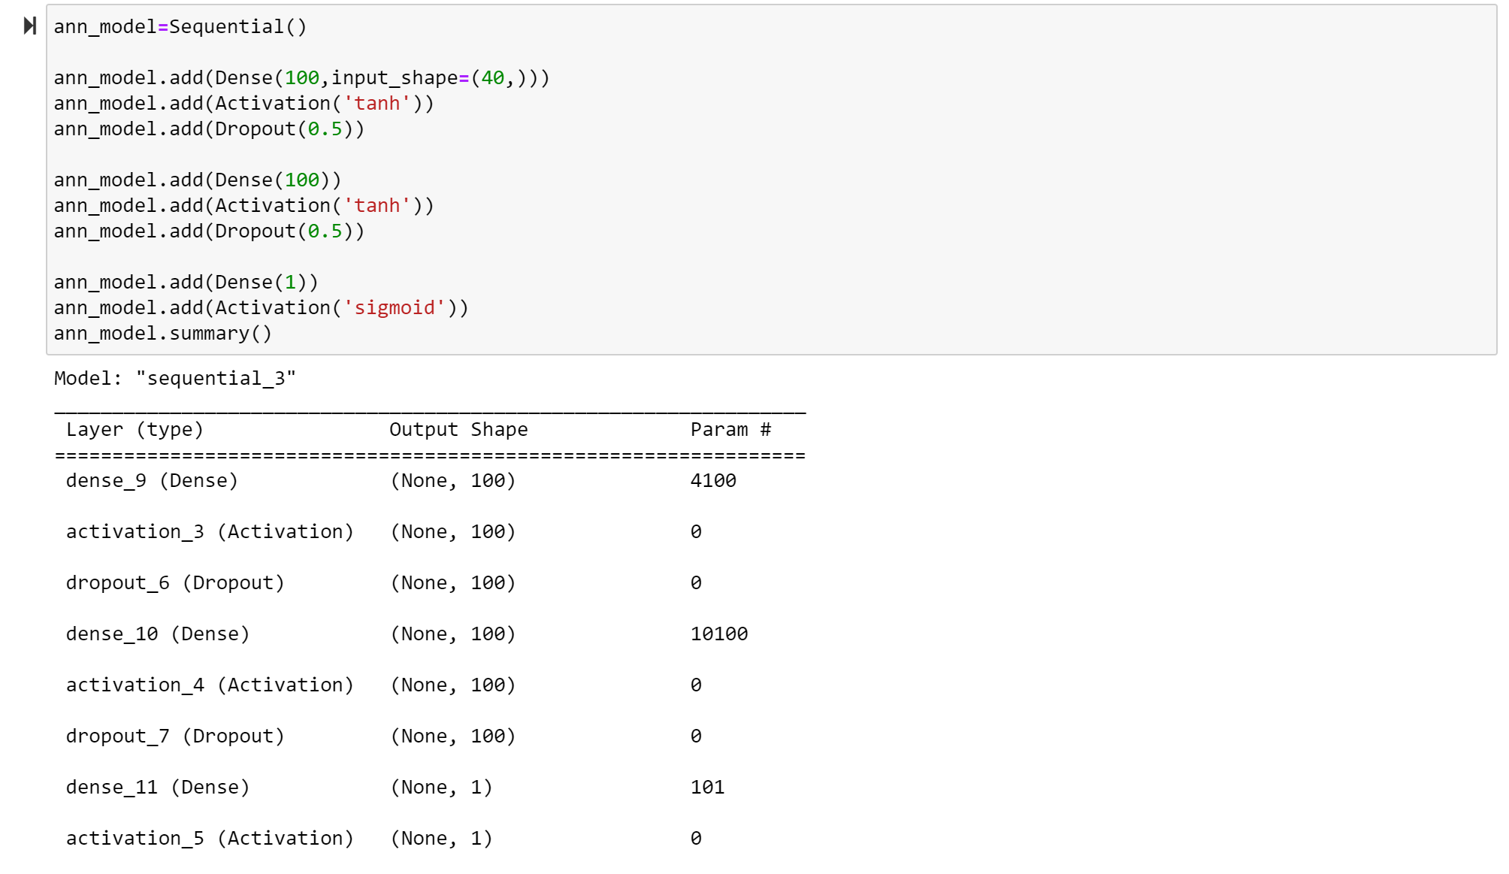
Architecture Of Feed Forward Neural Network Model:

Slide 14
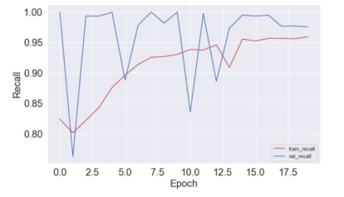
Long Short-Term Memory Neural Network
Hyperparameters
Hidden Layers: 3
Epochs: 20
Batch Size: 32
Dropout: 0.3 , 0.5

Slide 15
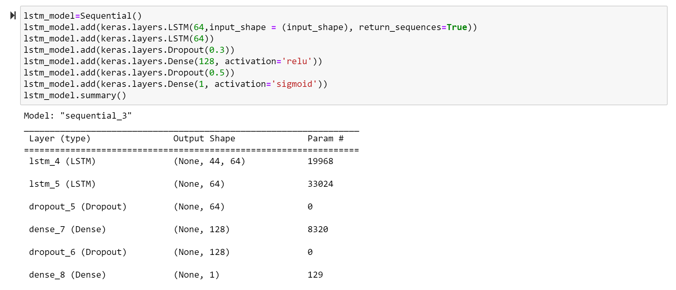
Architecture Of Long Short-Term Memory Neural Network Model:

Slide 16
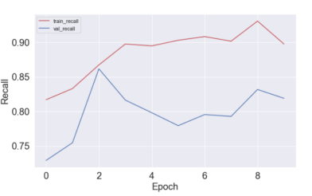
Convolutional Neural Network
Hyperparameters
Hidden Layers: 2
Epochs: 10
Dropout: 0.3

Slide 17
Conclusion
In conclusion, LSTM neural network model has the best performance on classifying heart conditions through audio. While the feed-forward neural network model provides high recall, it suffers from overfitting. We can see that the validation recall of the feed-forward model is always close to one, Which indicates that the model is not learning. On the other hand, CNN performed poorly because it's designed to work effectively on image data

Slide 18


THANKS!
Do you have any questions?

